Slide 1

A Sentiment Analysis for Social Media Comments or Product Reviews
Gökhan ÇEKÇİ 190101041 Mehmet Tarık AYVAZ 190101034

Slide 2

1. Project Objective
The objective of this project is to perform text-based sentiment analysis. Two different methods have been used for this purpose: classical machine learning algorithms and deep learning algorithms. Both methods aim to determine whether tweets contain positive or negative sentiment.

Slide 3

2. Innovations
1.Text Cleaning
Text cleaning processes have been optimized to effectively remove noise from social media data.
2. Comparison of Different Models
The performance of classical machine learning models (SVM, Naive Bayes, Random Forest, Logistic Regression) and deep learning models (LSTM) has been compared.
3. TF-IDF Vectorization
Using the TF-IDF method, texts were converted into numerical data and vectorized based on the importance of words.
4. LSTM-Based Model
An LSTM-based model was used to achieve higher accuracy rates by considering the time series characteristics of the texts.
5. Performance and Computation Balance
A balanced performance evaluation was conducted between classical and deep learning methods.

Slide 4

3. Dataset
3.1 Loading and Preparing the Dataset
The dataset was sourced from Kaggle.com, specifically the "Sentiment140 dataset with 1.6 million tweets". Different subsets of the data were used for machine learning and deep learning algorithms: 2000 tweets for machine learning and 50000 tweets for deep learning. Increasing the dataset size for machine learning algorithms did not significantly improve success rates, whereas it did for deep learning algorithms.
In both code segments, the dataset was loaded using the pandas library. Unnecessary columns were removed, retaining only the sentiment and text columns.

Slide 5

3.2 Text Cleaning
Text cleaning was performed in both codes. URLs, usernames, hashtags, numbers, and extra spaces were removed during the cleaning process. The texts were converted to lowercase.
def clean_text(text):
text = re.sub(r'http\S+', '', text) # Remove URLs
text = re.sub(r'@\w+', '', text) # Remove usernames
text = re.sub(r'#\w+', '', text) # Remove hashtags
text = re.sub(r'\d+', '', text) # Remove numbers
text = re.sub(r'\s+', ' ', text) # Remove extra spaces
text = text.lower().strip() # Convert to lowercase and strip spaces
return text
data['text'] = data['text'].apply(clean_text)

Slide 6

3.3 Converting Classes to Numerical Values
In the deep learning approach, classes were converted to numerical values using LabelEncoder.
le = LabelEncoder()
data['sentiment'] = le.fit_transform(data['sentiment'])

Slide 7

4. Splitting into Training and Test Sets
The dataset was split into training and test sets using the train_test_split function in both code segments.
X_train, X_test, y_train, y_test = train_test_split(data['text'], data['sentiment'], test_size=0.2, random_state=42)

Slide 8

5. Classical Machine Learning Approach
5.1 TF-IDF Vectorization
Texts were converted into numerical data using the TF-IDF method, with the top 1000 most frequently used words being selected.
vectorizer = TfidfVectorizer(max_features=1000)
X_train_tfidf = vectorizer.fit_transform(X_train)
X_test_tfidf = vectorizer.transform(X_test)

Slide 9

5.2 Training and Evaluating Models
Different machine learning algorithms were used to train models, which were then evaluated on the test set. The algorithms used include SVM, Naive Bayes, Random Forest, and Logistic Regression.

Slide 10
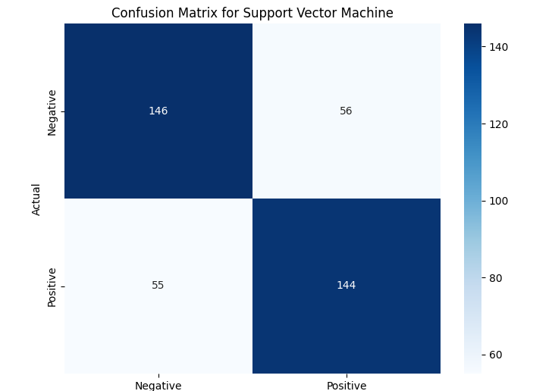
5.3 Results and Visualization
Accuracy, classification reports, and confusion matrices were calculated and visualized for each model.
Model: Support Vector Machine
Accuracy: 0.7232
Cross-validation scores: [0.65625, 0.66875, 0.6625, 0.69375, 0.75]
Mean CV score: 0.68625

Slide 11
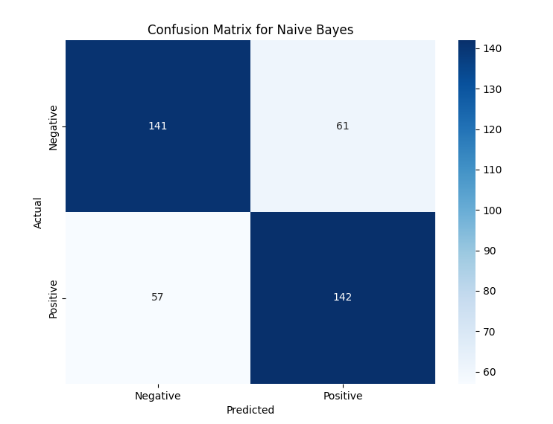
Model: Naive Bayes
Accuracy: 0.7057
Cross-validation scores: [0.665625, 0.6625, 0.653125, 0.69375, 0.728125]
Mean CV score: 0.680625

Slide 12
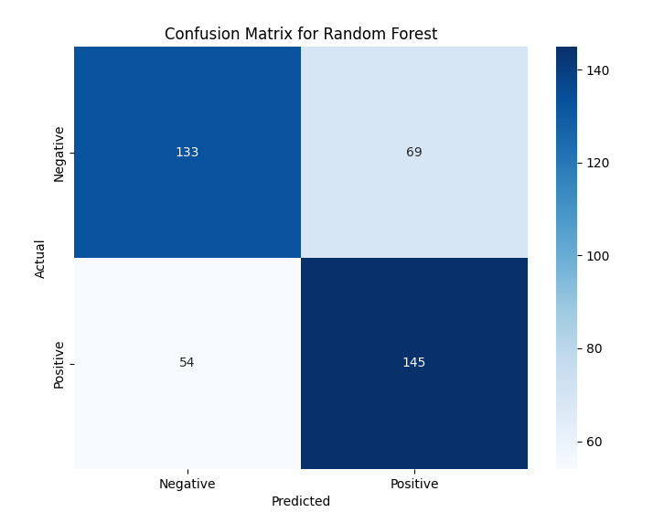
Model: Random Forest
Accuracy: 0.6933
Cross-validation scores: [0.6125, 0.675, 0.625, 0.665625, 0.7]
Mean CV score: 0.655625

Slide 13
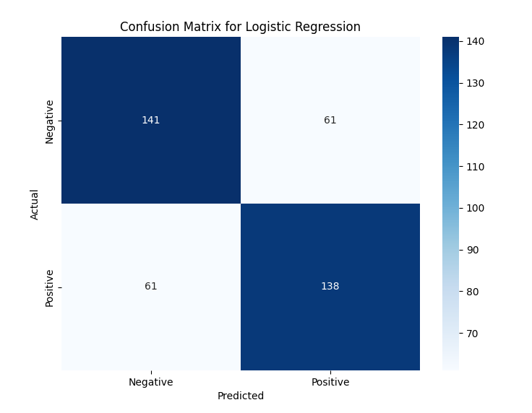
Model: Logistic Regression
Accuracy: 0.6958
Cross-validation scores: [0.659375, 0.665625, 0.65625, 0.69375, 0.74375]
Mean CV score: 0.68375

Slide 14

6. Deep Learning Approach
6.1 Tokenization and Padding
Texts were tokenized and padded to a fixed length. Texts were converted to numerical values using the Tokenizer, and fixed-length sequences were created with pad_sequences.
tokenizer = Tokenizer(num_words=10000)
tokenizer.fit_on_texts(X_train)
X_train_seq = tokenizer.texts_to_sequences(X_train)
X_test_seq = tokenizer.texts_to_sequences(X_test)
X_train_pad = pad_sequences(X_train_seq, maxlen=100)
X_test_pad = pad_sequences(X_test_seq, maxlen=100)

Slide 15

6.2 One-Hot Encoding
Classes were converted using one-hot encoding:
num_classes = 2
y_train_cat = to_categorical(y_train, num_classes=num_classes)
y_test_cat = to_categorical(y_test, num_classes=num_classes)

Slide 16

6.3 Model Creation and Training
An LSTM-based model was created and trained. The model consists of Embedding, LSTM, and Dense layers:
def create_model():
model = Sequential()
model.add(Embedding(input_dim=10000, output_dim=32))
model.add(LSTM(100))
model.add(Dense(num_classes, activation='softmax'))
model.compile(optimizer='adam', loss='categorical_crossentropy', metrics=['accuracy'])
return model
model = create_model()
history = model.fit(X_train_pad, y_train_cat, epochs=3, batch_size=32, validation_data=(X_test_pad, y_test_cat), verbose=2)

Slide 17

6.4 Model Performance Evaluation
The model's performance was evaluated on the test set. Predictions were made, and accuracy was calculated. Confusion matrices and classification reports were created.
loss, accuracy = model.evaluate(X_test_pad, y_test_cat, verbose=0)
print(f'Accuracy: {accuracy}')
y_pred_prob = model.predict(X_test_pad)
y_pred = np.argmax(y_pred_prob, axis=1)
y_test_labels = np.argmax(y_test_cat, axis=1)

Slide 18

conf_matrix = confusion_matrix(y_test_labels, y_pred)
print("Confusion Matrix:\n", conf_matrix)
print("Classification Report:\n", classification_report(y_test_labels, y_pred))
plt.figure(figsize=(8, 6))
sns.heatmap(conf_matrix, annot=True, fmt='d', cmap='Blues', xticklabels=['Negative', 'Positive'], yticklabels=['Negative', 'Positive'])
plt.xlabel('Predicted')
plt.ylabel('Actual')
plt.title('Confusion Matrix')
plt.show()

Slide 19

6.5 Cross-Validation
The model's performance was evaluated using cross-validation. K-Fold cross-validation was used.
kf = KFold(n_splits=3, shuffle=True, random_state=42)
cv_accuracy = []
for train_index, val_index in kf.split(X_train_pad):
X_train_kf, X_val_kf = X_train_pad[train_index], X_train_pad[val_index]
y_train_kf, y_val_kf = y_train_cat[train_index], y_train_cat[val_index]
model = create_model()
model.fit(X_train_kf, y_train_kf, epochs=3, batch_size=32, verbose=1)
loss, accuracy = model.evaluate(X_val_kf, y_val_kf, verbose=0)
cv_accuracy.append(accuracy)

Slide 20
6.6 Results and Visualization
Epoch 1/3
1250/1250 - 45s - 36ms/step - accuracy: 0.7398 - loss: 0.5208 - val_accuracy: 0.7829 - val_loss: 0.4716
Epoch 2/3
1250/1250 - 44s - 35ms/step - accuracy: 0.8095 - loss: 0.4191 - val_accuracy: 0.7846 - val_loss: 0.4638
Epoch 3/3
1250/1250 - 43s - 34ms/step - accuracy: 0.8400 - loss: 0.3675 - val_accuracy: 0.7772 - val_loss: 0.4864
Accuracy: 0.7771999835968018
←[1m313/313←[0m ←[32m━━━━━━━━━━━━━━━━━━━━←[0m←[37m←[0m ←[1m4s←[0m 13ms/step

Slide 21
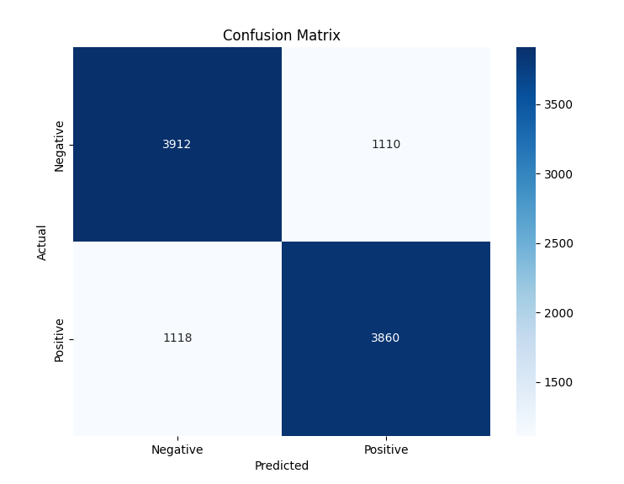
Confusion Matrix:

Slide 22

Classification Report:
precision recall f1-score support
0 0.78 0.78 0.78 5022
1 0.78 0.78 0.78 4978
accuracy 0.78 10000
macro avg 0.78 0.78 0.78 10000
weighted avg 0.78 0.78 0.78 10000

Slide 23
Epoch 1/3
←[1m834/834←[0m ←[32m━━━━━━━━━━━━━━━━━━━━←[0m←[37m←[0m ←[1m32s←[0m 37ms/step - accuracy: 0.6751 - loss: 0.5887
Epoch 2/3
←[1m834/834←[0m ←[32m━━━━━━━━━━━━━━━━━━━━←[0m←[37m←[0m ←[1m31s←[0m 37ms/step - accuracy: 0.8164 - loss: 0.4163
Epoch 3/3
←[1m834/834←[0m ←[32m━━━━━━━━━━━━━━━━━━━━←[0m←[37m←[0m ←[1m31s←[0m 37ms/step - accuracy: 0.8512 - loss: 0.3522
Cross-validation scores: [0.7624868750572205, 0.7644191384315491, 0.7554188966751099]
Mean CV score: 0.7607749700546265

Slide 24

7. Comparison and Comments
Performance Comparison:
The deep learning model generally provided higher accuracy than classical machine learning models.
Among the classical machine learning models, Logistic Regression performed the best.
Challenges and Advantages:
Classical machine learning methods require fewer computational resources and are faster to train.
Deep learning methods require more data and computational resources but generally achieve higher accuracy.

Slide 25

8. Web Application Initially, the model was trained, and a server was created. Then, a web page was prepared and made testable. Users can now enter text messages to find out whether they contain positive or negative emotional content.

Slide 26
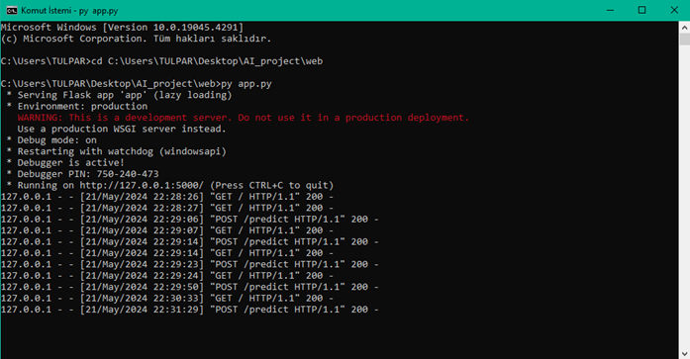

Slide 27
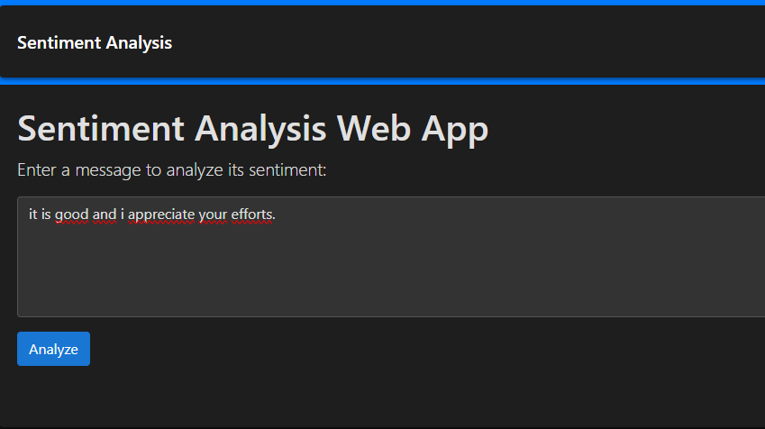

Slide 28
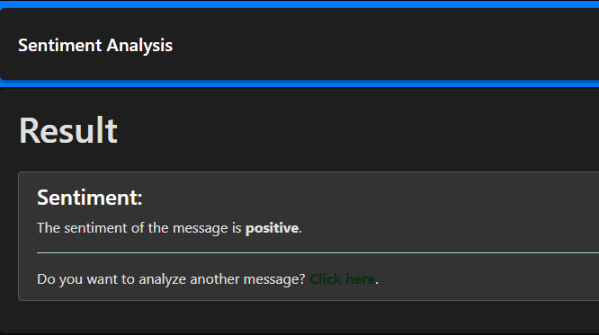

Slide 29

9. Conclusion
In this project, both classical machine learning and deep learning methods were applied and compared for text-based sentiment analysis. The deep learning method generally provided higher accuracy. However, classical machine learning methods are faster and require fewer computational resources, making them a suitable alternative for small datasets.

Slide 30

THANKS FOR LISTENING!

